Slide 1

B2B Integration
Architecture Overview
Kluckner Thomas
Haider Florian

Slide 2
Overview Part 1
Introduction
Invocation Pattern
Component Structure
  Component Interface
  Component Parts

Slide 3
Overview Part 2
State – Based Architecture
Coordinated Architecture
  User Interface Invocations
  Invocations Processing Incoming Events
Integration Example

Slide 4
Introduction Part 1
Architectural principles
Overall description of the system behaviour

Slide 5
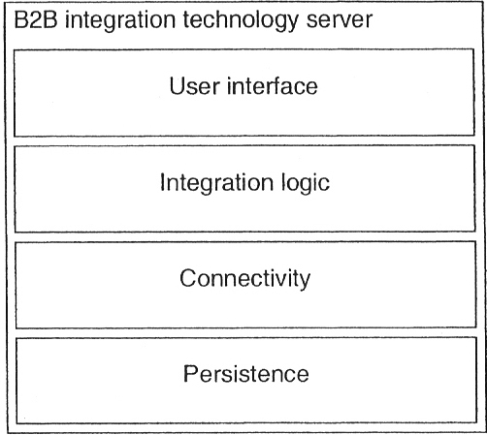
Introduction Part 2
4-Layer Architecture
  Each Layer: Several Components
Interaction is top down
No Layer skipped!
Each Layer calls underlying layer to get his functionality

Slide 6
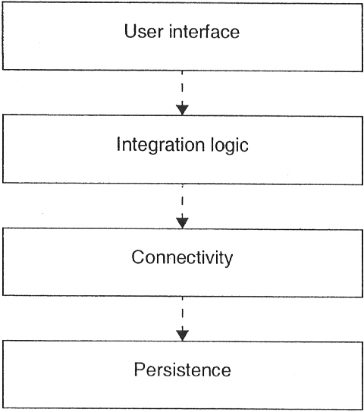
Invocation Pattern Part 1
may cause problems
(e.g.: Integration L. Layer calls for object instance)
solution: auxiliary components (→ provide certain necessary operations)

Slide 7
Invocation Pattern Part 2
Why have this encapsulation with aux. Components? In the implementation layers can be skipped anyway...
Main reason: filtering of operations
→ clear architecture description
→ easier to construct
In implementation: additional requirements, e.g. performance and scalability

Slide 8
Component Structure Interface Part 1
Interface → operations with according parameters
Each component has interfaces to provide to invoking components
  „public export interface“
  „layer private component interface“

Slide 9
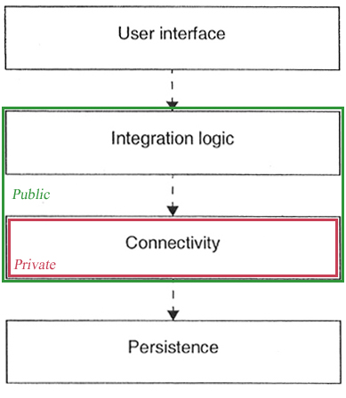
Component Structure
Interface Part 2
Public export interface → visible for both components in same layer and those from layer above
Layer private component interface → visible only for components in same layer

Slide 10
Component Structure Interface Part 3
Example: Interface for creating interface process type
create_interface_process_type( IN type_name: string, OUT identifier: integer )
OUT → each parameter must be defined either IN or OUT
identifier → parameter name
integer → data type

Slide 11
Component Structure
Parts Part 1
Components responsible for modelling data → must deal with type and instance data simultaneously
E.g.: process management component (integration logic layer)
→ manages process types and process instances of those types

Slide 12
Component Structure
Parts Part 2
Alternative Solutions:
Separation of operations on type and instance data in component interfaces
+ clear structure
+ clear invocation behaviour
2 components instead of 1
(one for type, one for instance data)
+ clearer separations
- functionality applied to both
can‘t be easily shared

Slide 13
State-Based Architecture
Part 1
Presented architecture → state-based
Integration instances and types have life-cycle model and are in certain state
Persistence layer holds consistent and complete set of type and instance data at all points in time
Data can be shared between several components

Slide 14
State-Based Architecture
Part 2
Alternative Solution:
Queue-based architecture
Components don‘t share common data model
Data is passed between themselves in form of queue elements (messages)

Slide 15
State-Based Architecture
Part 3
Problems:
Data only in queue (element must contain type and instance data)
No common state available (data can‘t be shared through shared persistent state)
Main problem: 2 components work on same data (each one has copy of data) → one comp. changes data, the other one can‘t notice the change
→ lack of consistence!!

Slide 16
Coordinated Architecture
Requests from user interface, incoming messages
Specific invocation of several components
Coordintation required

Slide 17
Coordinated Architecture
User Interface Invocations
User Interface Layer
UI Comp. A
UI Comp. B
...
Integration Logic Layer
IL Comp. A
...
...
Connectivity Layer
CL Comp. A
...
Persistence Layer
PL Comp. A
...
Hierarchical Invocation Pattern
Important: Correct Invocation Order

Slide 18
Coordinated Architecture
Invocations Processing Incoming Events
Part 1
Incoming Message
Transport Component
Security Component
Packaging Component
...
Receives Message
Decrypts and accepts Message
Unpacks wire message packaging
→ Hierarchical Invocation Pattern originated at Transport Component

Slide 19
Coordinated Architecture
Invocations Processing Incoming Events
Part 2
Problems:
Invocation hierarchy starts at connectivity layer ➔ impossible to call processing components from integration logic layer
Transport component needs information about security component, which has to know about packaging component...
(components should focus on their functionality)

Slide 20
Coordinated Architecture
Invocations Processing Incoming Events
Part 3
Solution:
Connectivity and Integration Logic Layer have a „Coordinator component“
Coordinates invocation within one layer
Correct invocation and execution

Slide 21
Coordinated Architecture
Invocations Processing Incoming Events
Part 4
Coordinator Component
Incoming Message
Transport Component
Security Component
Packaging Component
...
Receives Message
Decrypts and accepts Message
Unpacks wire message packaging
→ Coordinator Component takes over invocation control when notified

Slide 22
Coordinated Architecture
Invocations Processing Incoming Events
Part 5
Advantages:
+ ensures components focus on their functionality
+ component don‘t need to know each other
+ enforces necessary invocations sequences
→ Indirect Communication between connectivity and integration logic layer:
  Connectivity layer processes incoming message and stores it in persistence layer
  Coordinator component of integration logic
  layer is notified and periodically checks for messages

Slide 23
Integration Example Part 1
one-way notification
trading partners A,B, Customer C
A: obliged to ship a product
A=>B: sends shipment notification
B: receives notification
B=>C: notify the customer by email

Slide 24
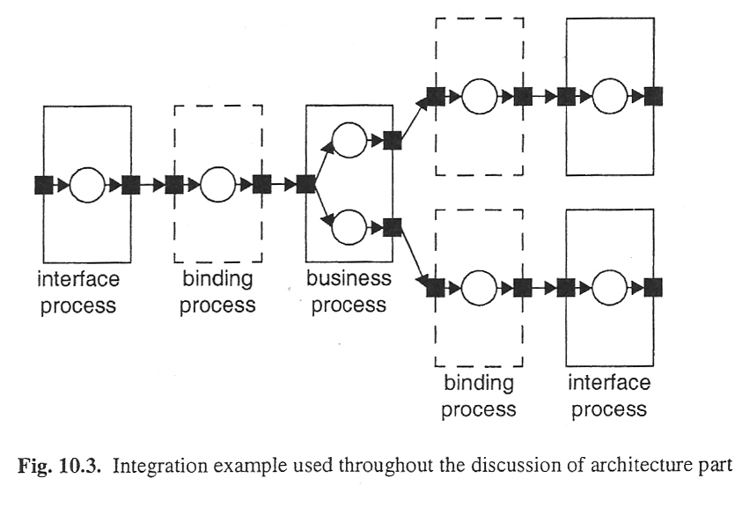
Integration Example Part 2
incoming notification is transformed, translated
business process splits the business event
business process sends out copies
different process bindings and interface processes

